Slide 1

ROUTE 53
Sameer Zulfi

Slide 2
DNS Basics
Domain Name System – Phonebook of the Internet
DNS translates domain names to IP addresses
DNS server eliminates the need for humans to memorize the IP addresses
www.example.com -> some ip address

Slide 3
DNS Basics
DNS Recursor/Resolver – Acts like Librarian who go and fetches the particular books. Usually managed by your ISPs
Client web browser send the queries to DNS Recursor
Root NameServer – This is the first step to translate or resolve human readable host name to ip address. It acts like an index which points to a different rack of the books
TLD NameServer – Top Level Domain Server – it’s like specific racks of books in a library. In example.com TLD server is .com
Authoritative NameServer - this is the final point or last stop to resolve the query. If this has the right ip for the requestes host name, then it will return the ip back to DNS Recursor (Librarian)

Slide 4
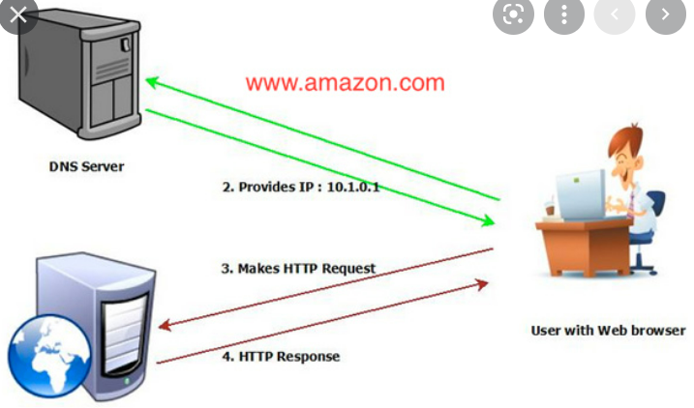
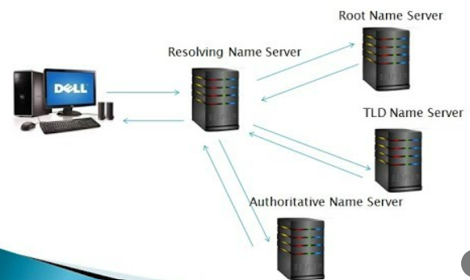
How DNS Works

Slide 5
Types of DNS Service
Router53 is one of the way DNS Service which translates human readable names to ip
Authoritative DNS: This has final authority to find the right ip at any cost. Route 53 is this DNS
Recursive DNS : Usually client will not hit the authoritative directly rather here. This acts as an intermediary and sometimes the queries would have cached here for some TTL. Finally it will pass the query to some authoritative DNS servers

Slide 6
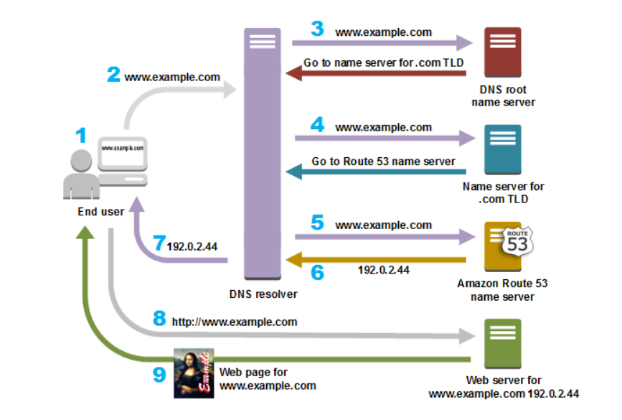
How does DNS Route traffic to your web application

Slide 7
Route 53
3 main functions
Domain Registration, DNS routing and health checking
After registration :
Host Zone Creation, Assign a set of 4 NS to the hosted zone
To route traffic, created resource record sets in hosted zone

Slide 8
Route 53 concepts
Domain name
Domain registrar
Domain registry - who can sell the domains – for ex ., verisign
TLD – Top Level Domain
Alias record – type of record to route the traffic to CFN and S3
Authoritative Name Server
DNS Query
DNS Resolver
DNS
Hosted Zone – where you are mentioning how to route traffic to different resources
IP Address - Record type A for IPV4 and AAAA for IPv6
Name Servers – either authoritative or recursive

Slide 9
Routing Policy
Simple Routing Policy
Failover Routing Policy
Geolocation
Geoproximity
Latency
Multivalue answer
Weighted

Slide 10
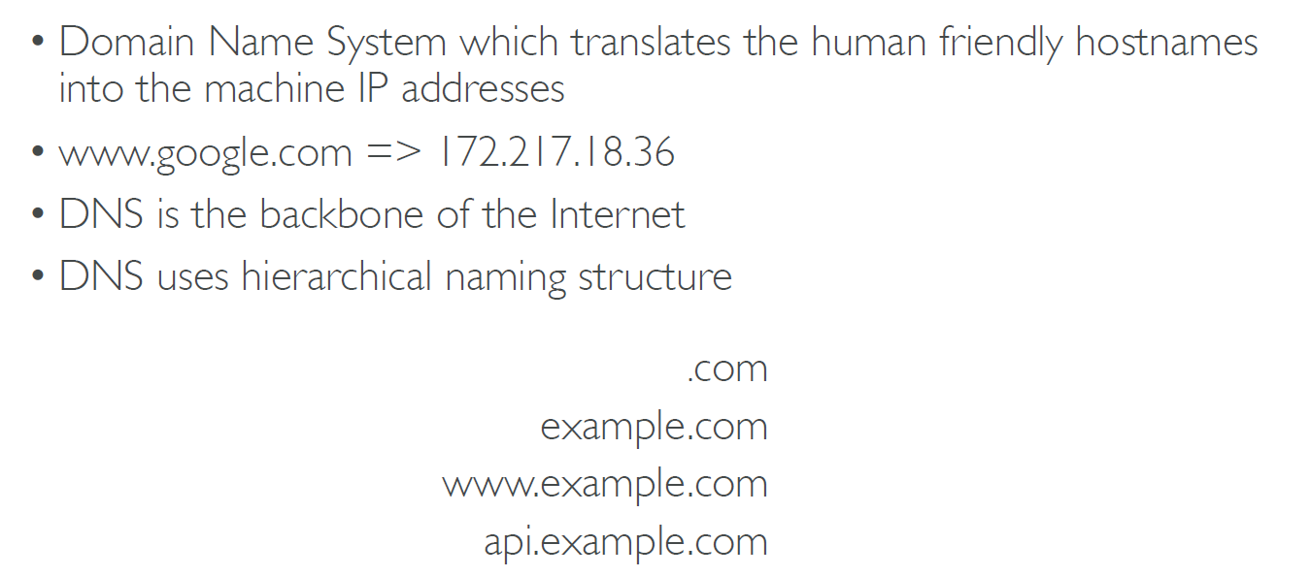
DNS

Slide 11
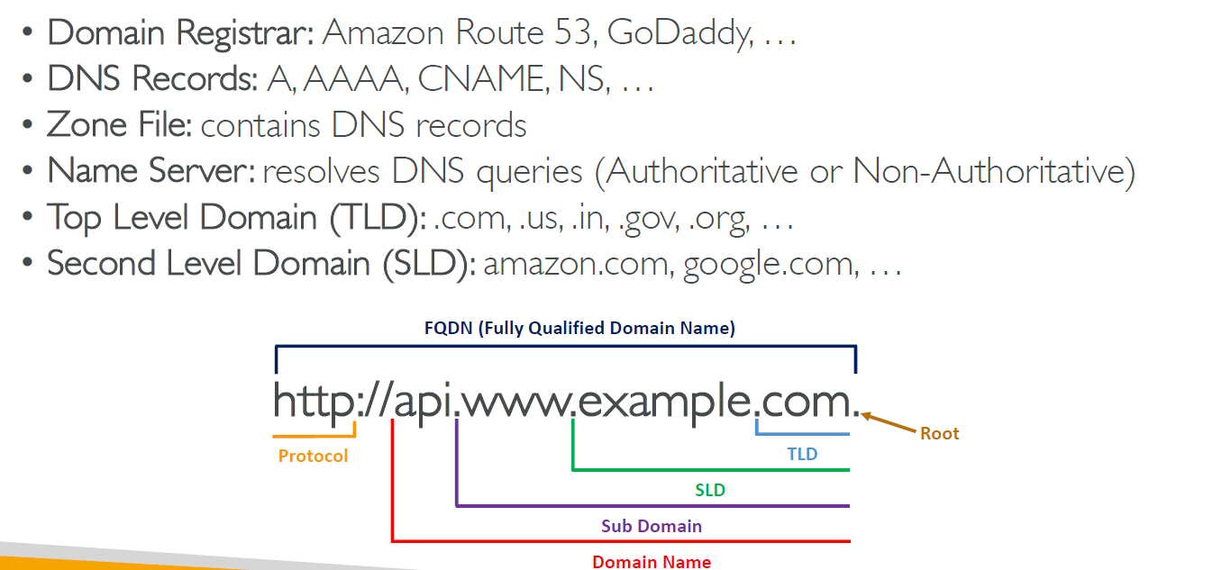
DNS Terminologies

Slide 12
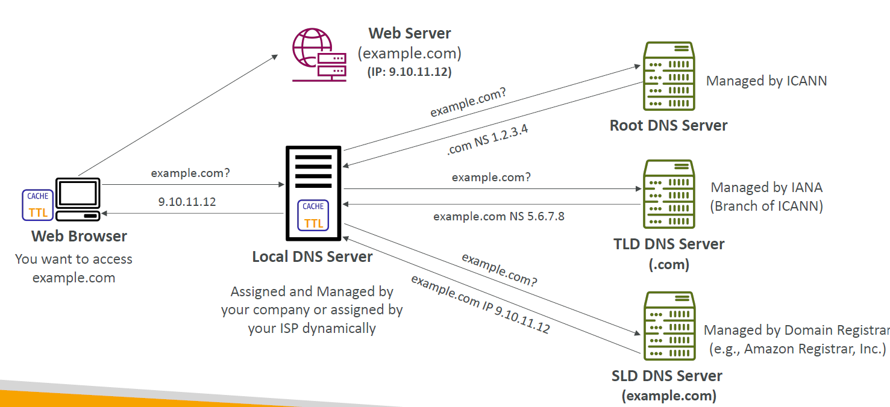
How DNS works?

Slide 13
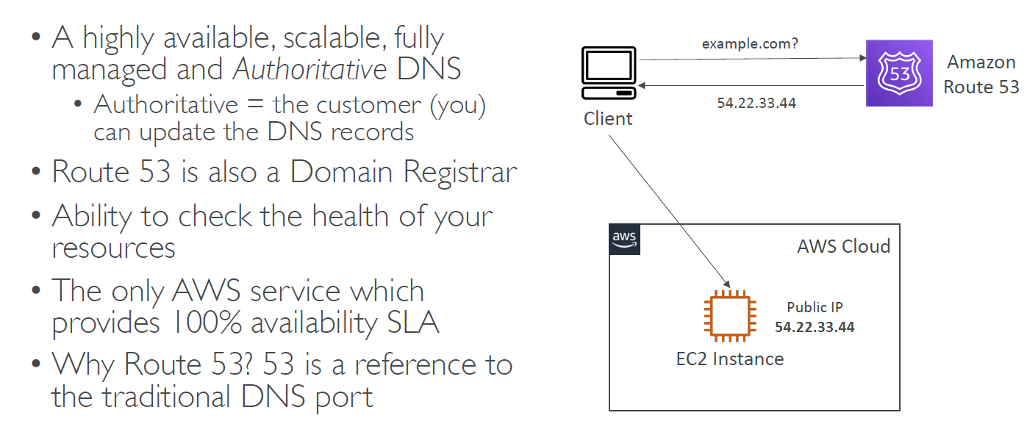
Amazon Route53

Slide 14
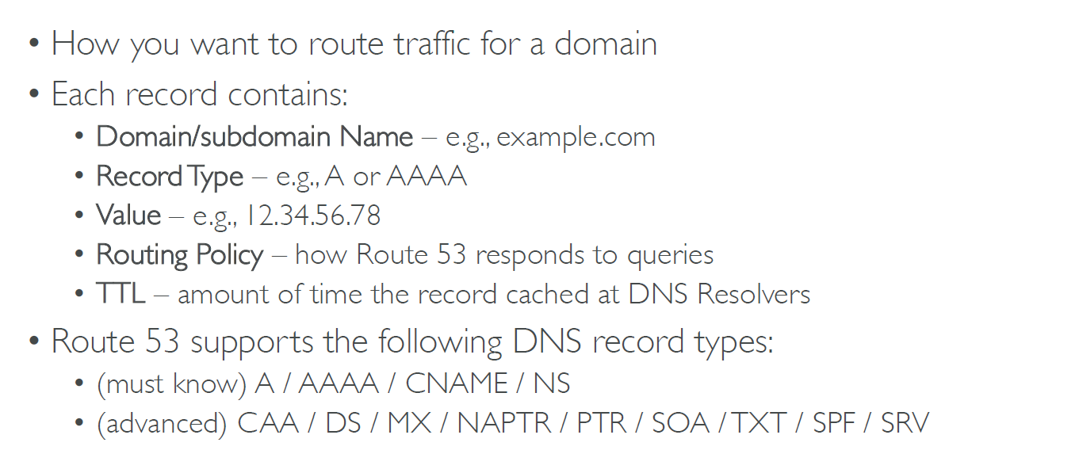
Route53 - Records

Slide 15
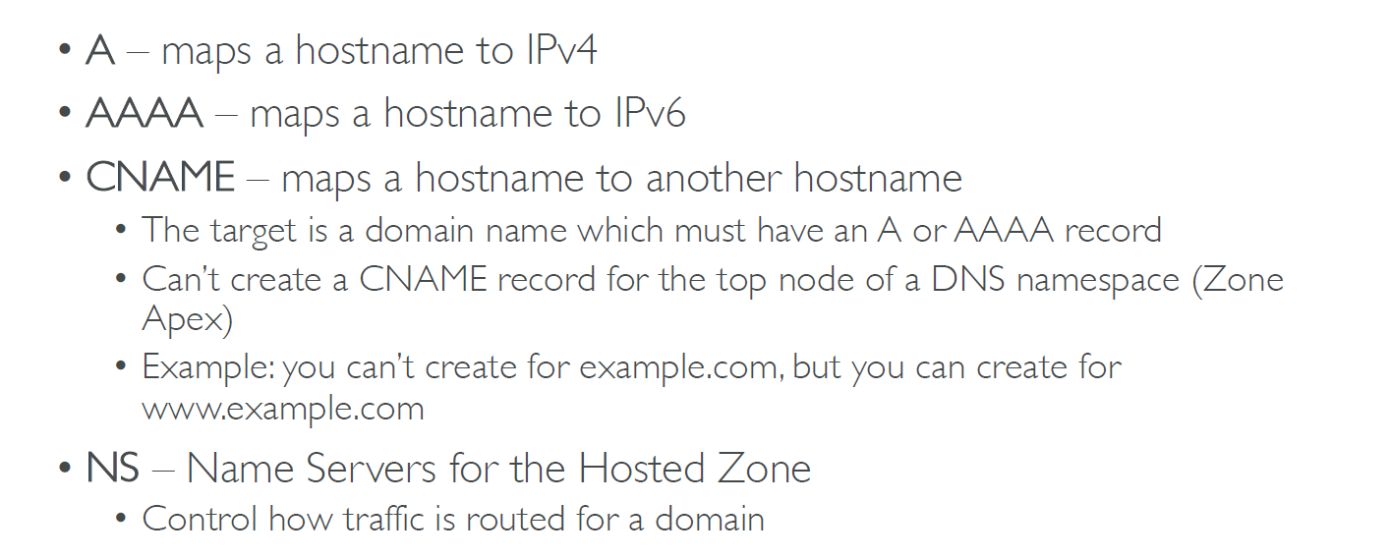
Route53 – Record types

Slide 16
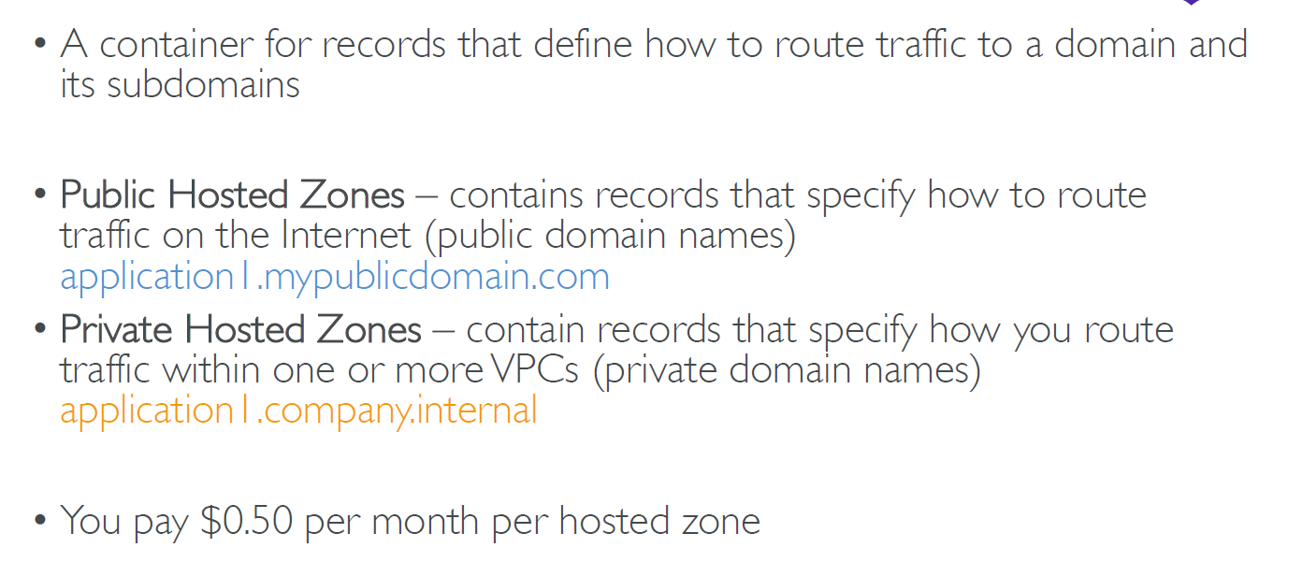
Route 53 – Hosted Zones

Slide 17
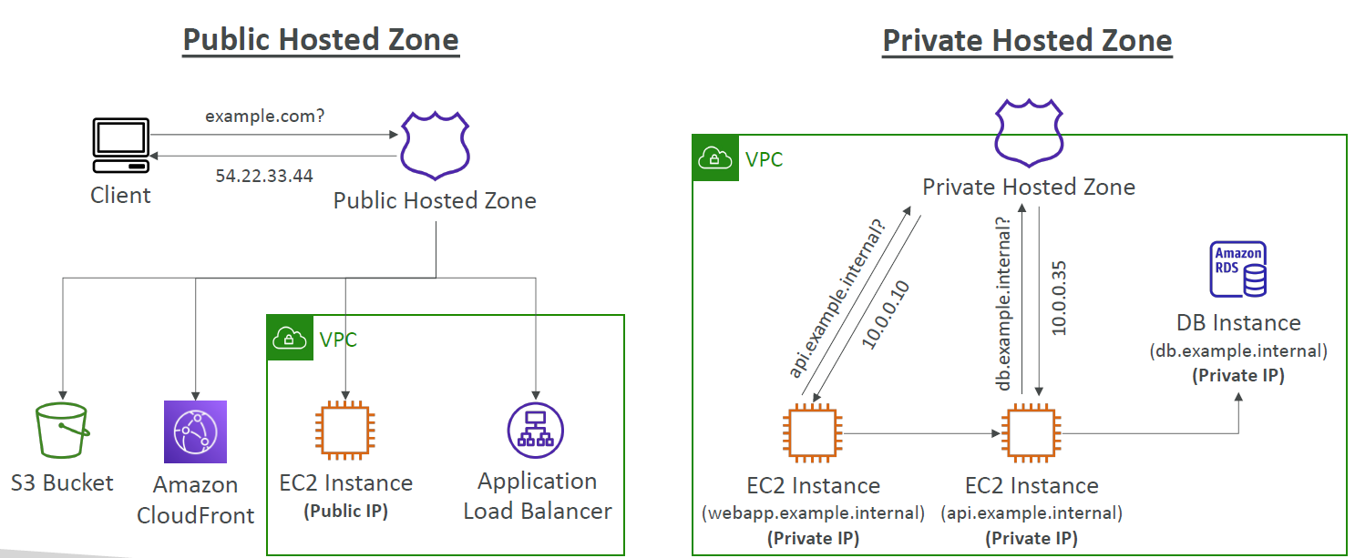
Route 53 – Public vs Private Hosted Zones

Slide 18
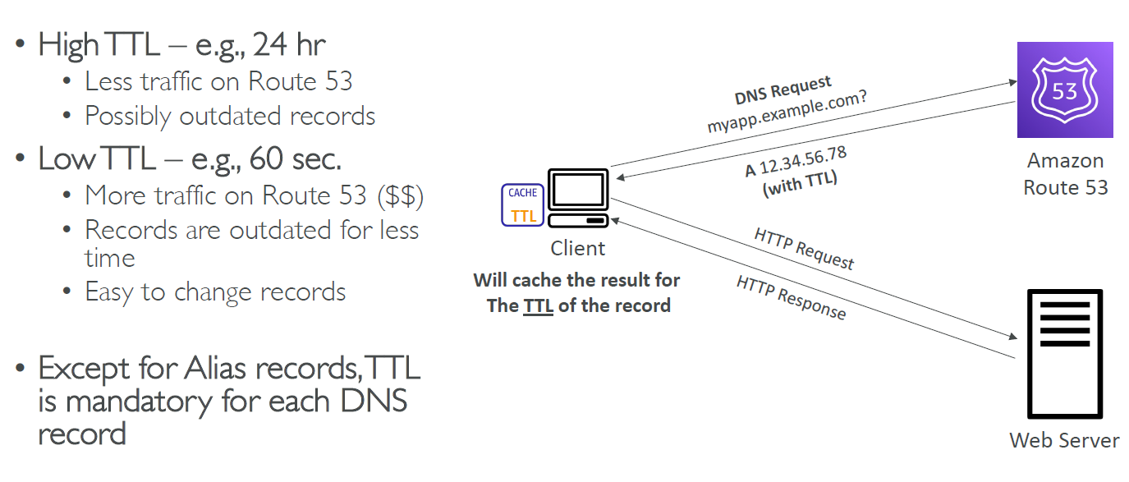
Route 53 – Records – TTL – Time to Live

Slide 19
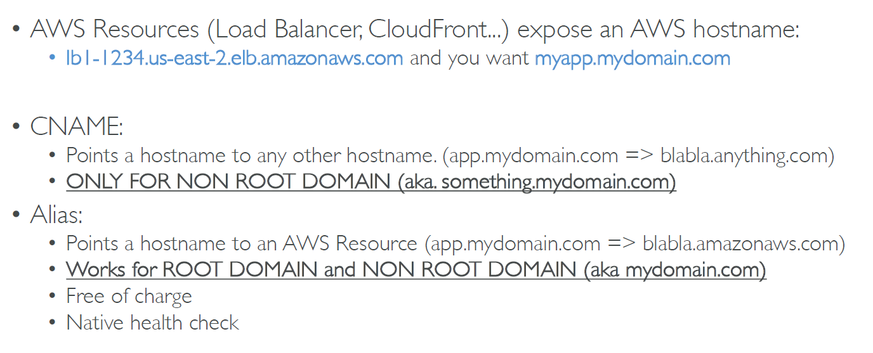
CNAME vs ALIAS

Slide 20
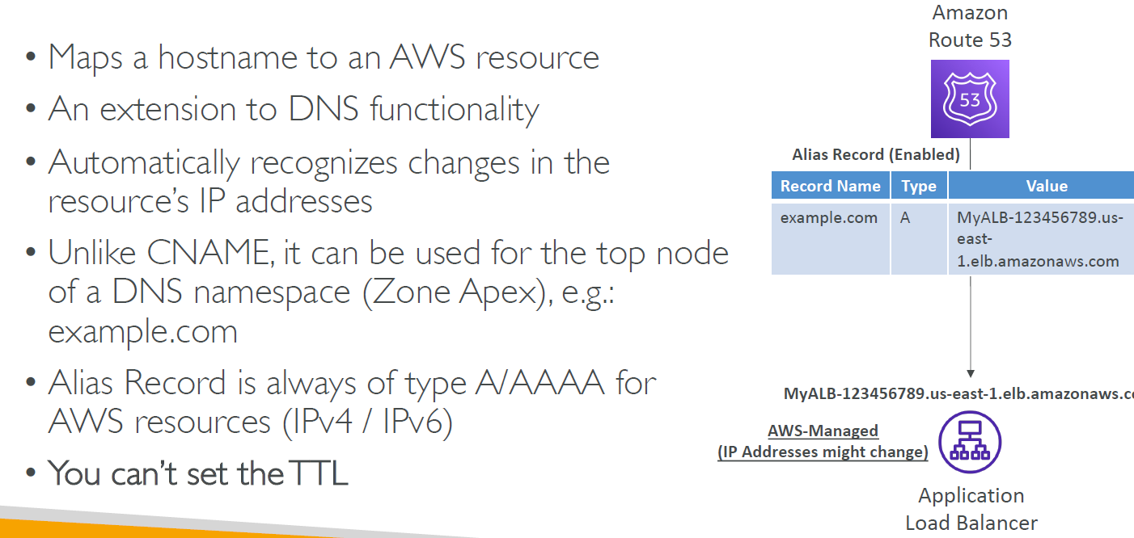
Route 53 – Alias Records

Slide 21
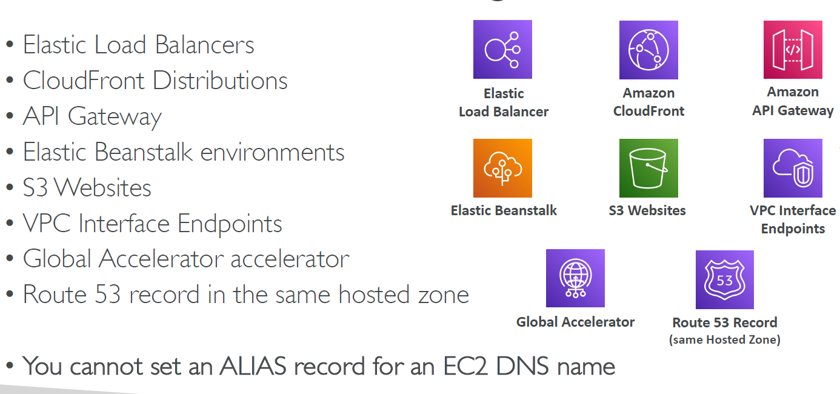
Route 53 – Alias Records Target

Slide 22
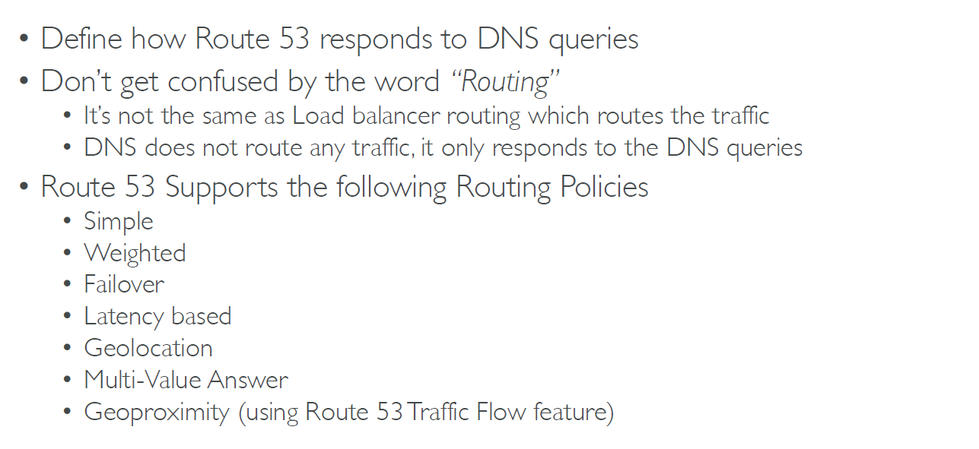
Route 53 – Routing Policies

Slide 23
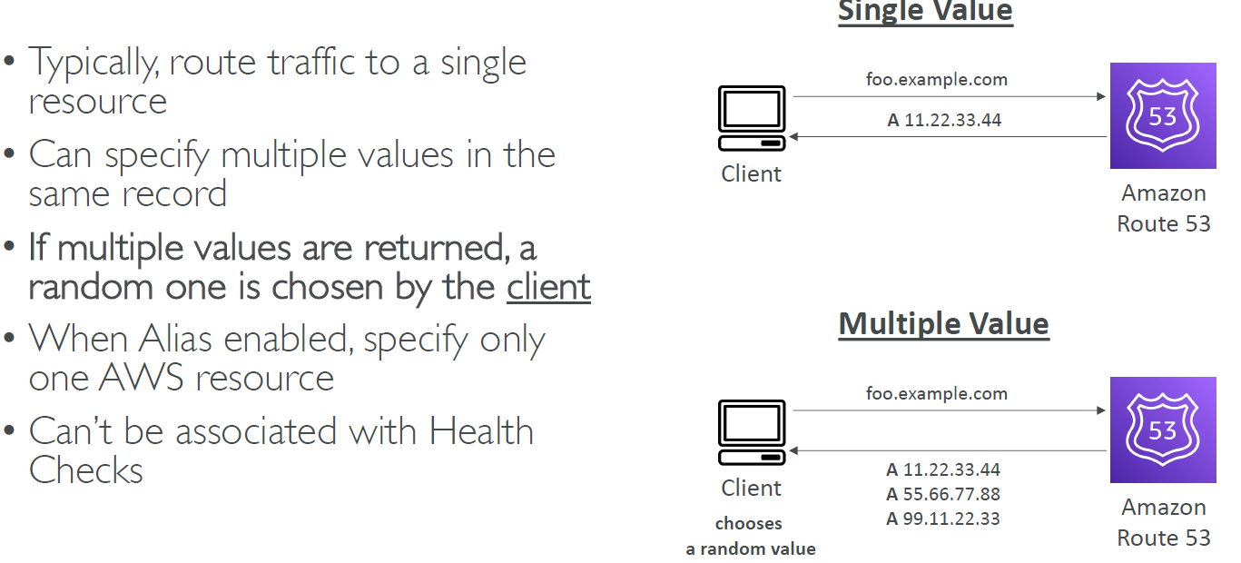
Routing Policies - Simple

Slide 24
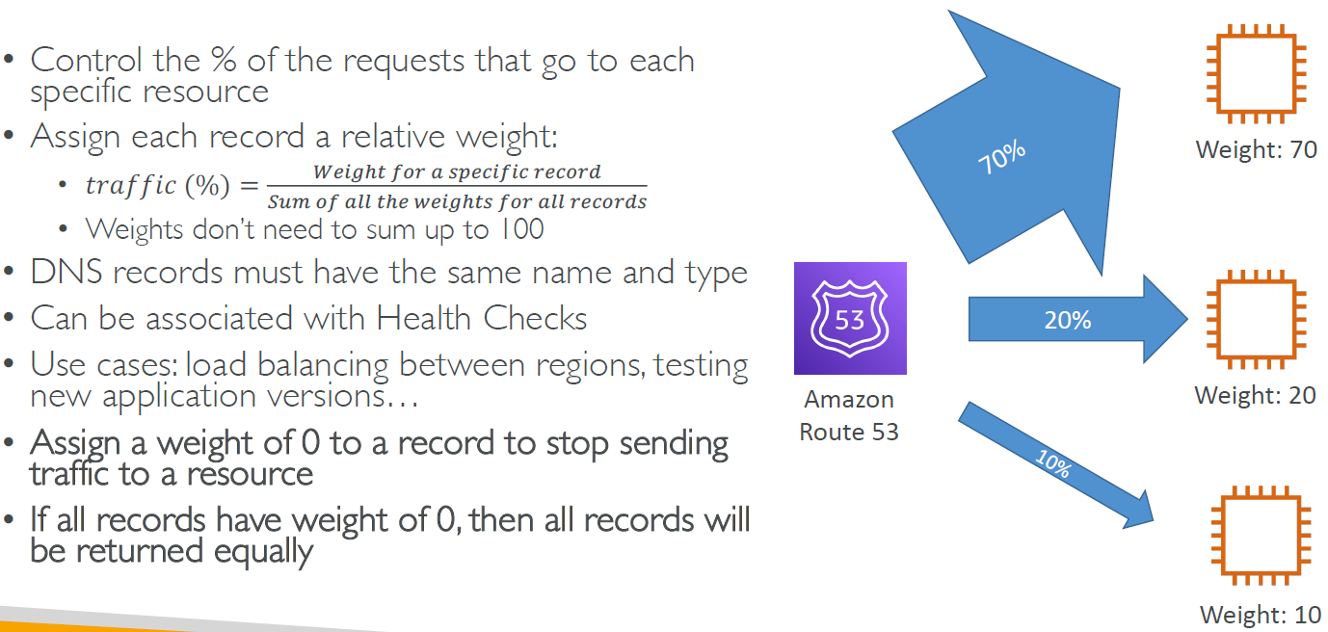
Routing Policies - Weighted

Slide 25
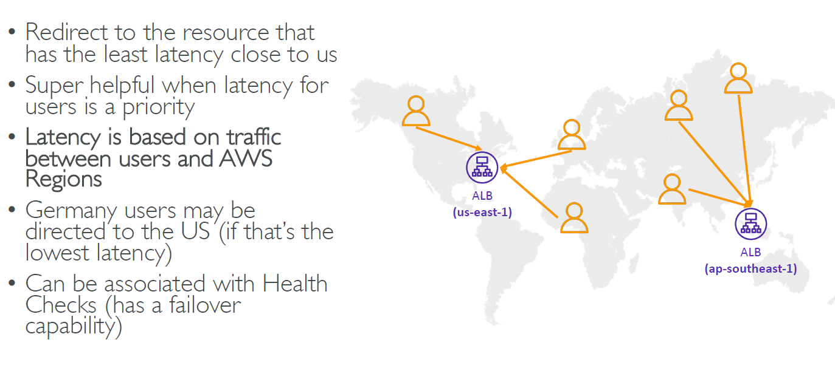
Routing Policies – Latency based

Slide 26
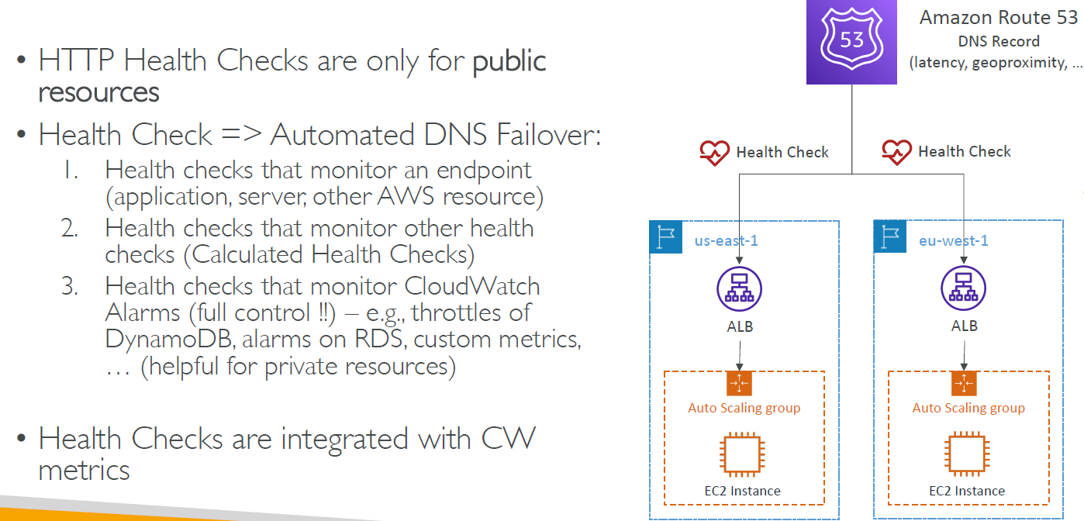
Route 53 – Health Checks

Slide 27
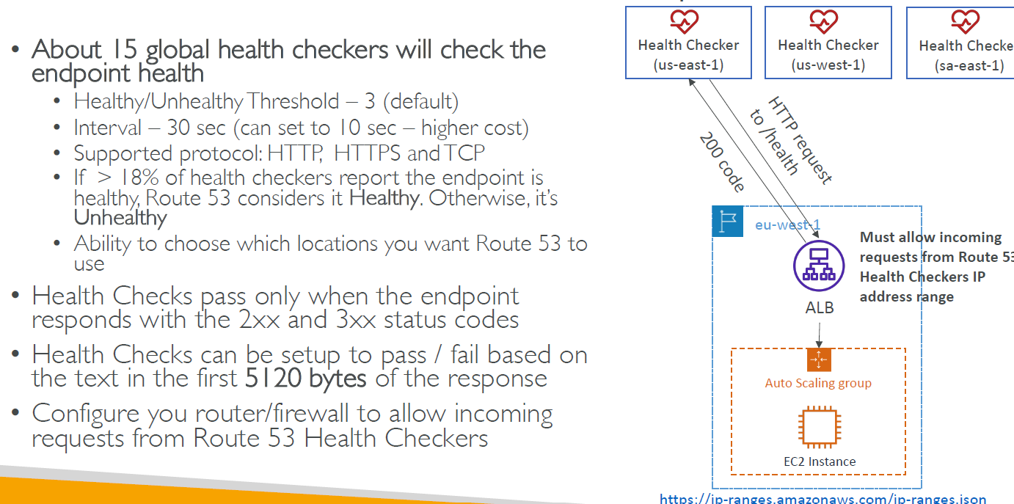
Health Checks – Monitor an Endpoint

Slide 28
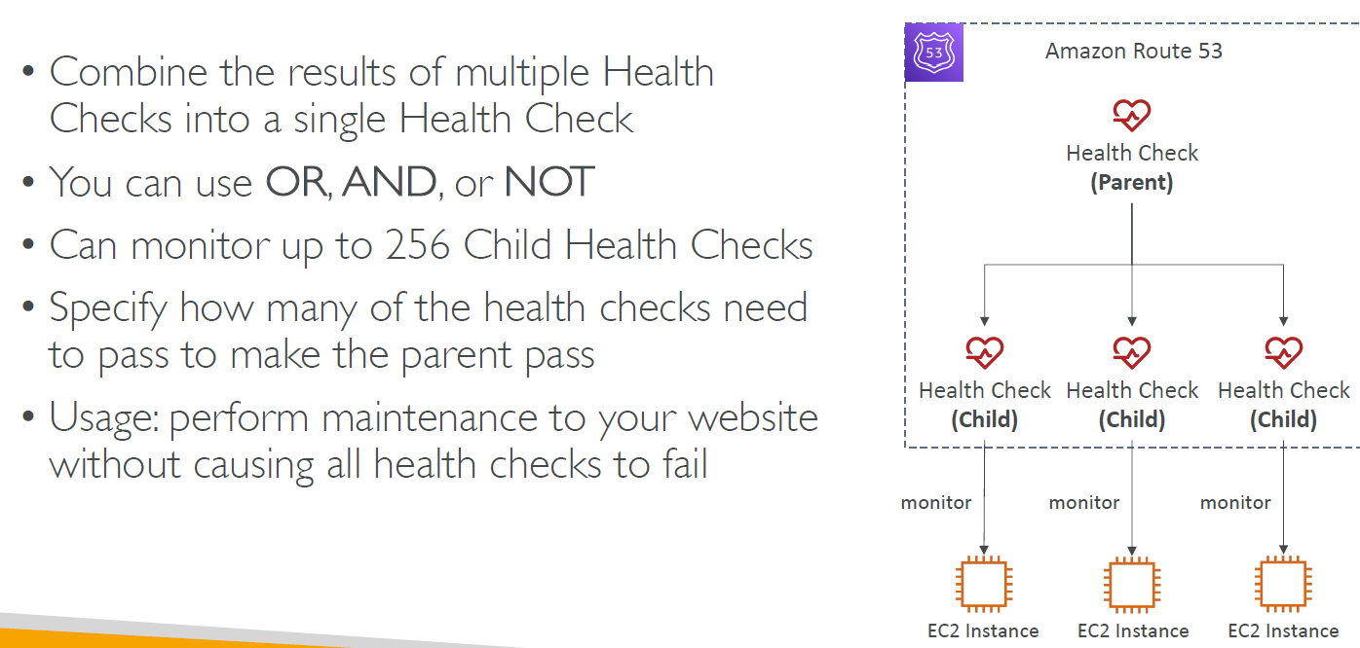
Route 53 – Calculated Health Checks

Slide 29
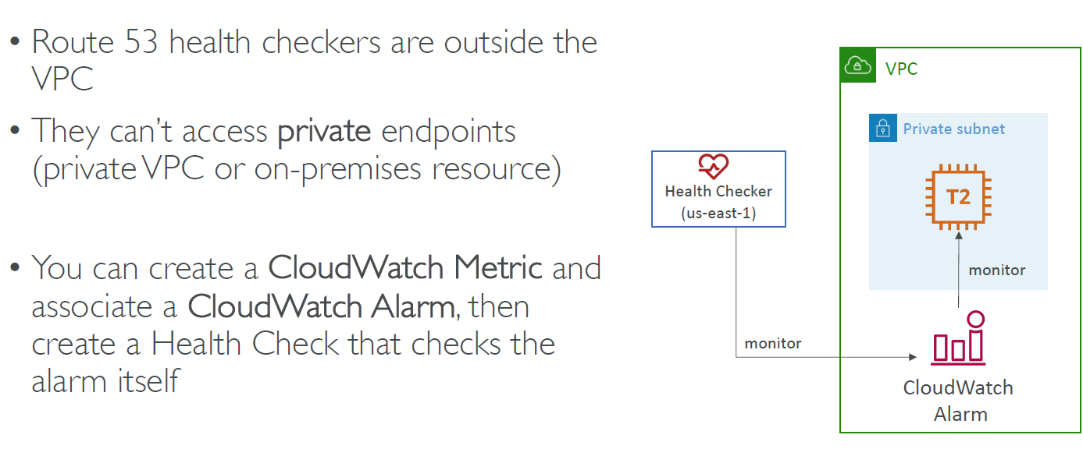
Health Checks – Private Hosted Zones

Slide 30
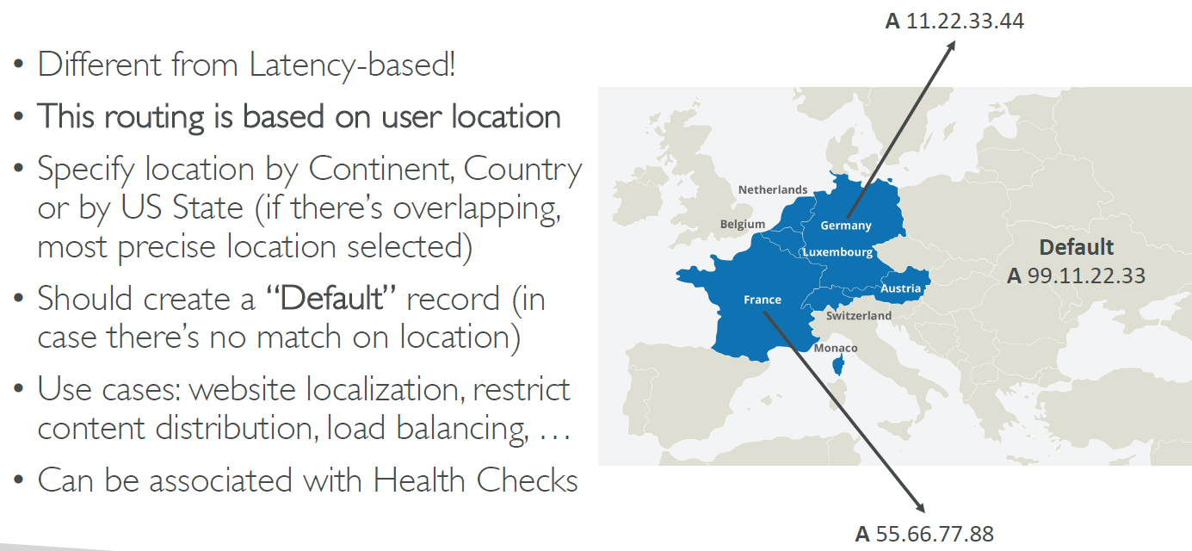
Routing Policies - Geolocation

Slide 31
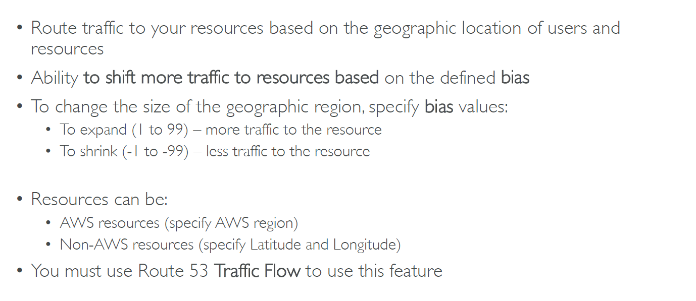
Routing Policies - Geoproximity

Slide 32
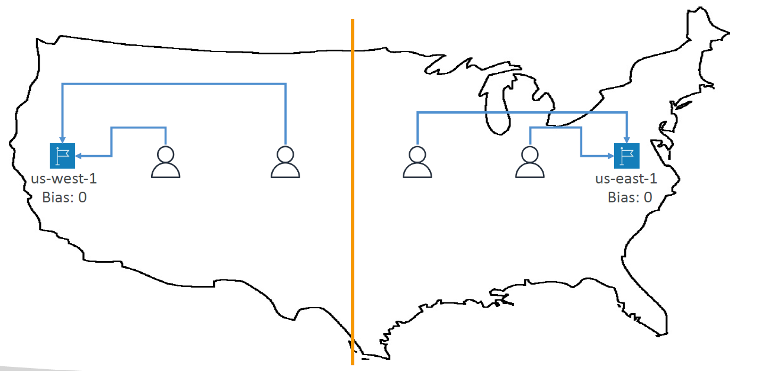
Routing Policies – Geoproximity

Slide 33
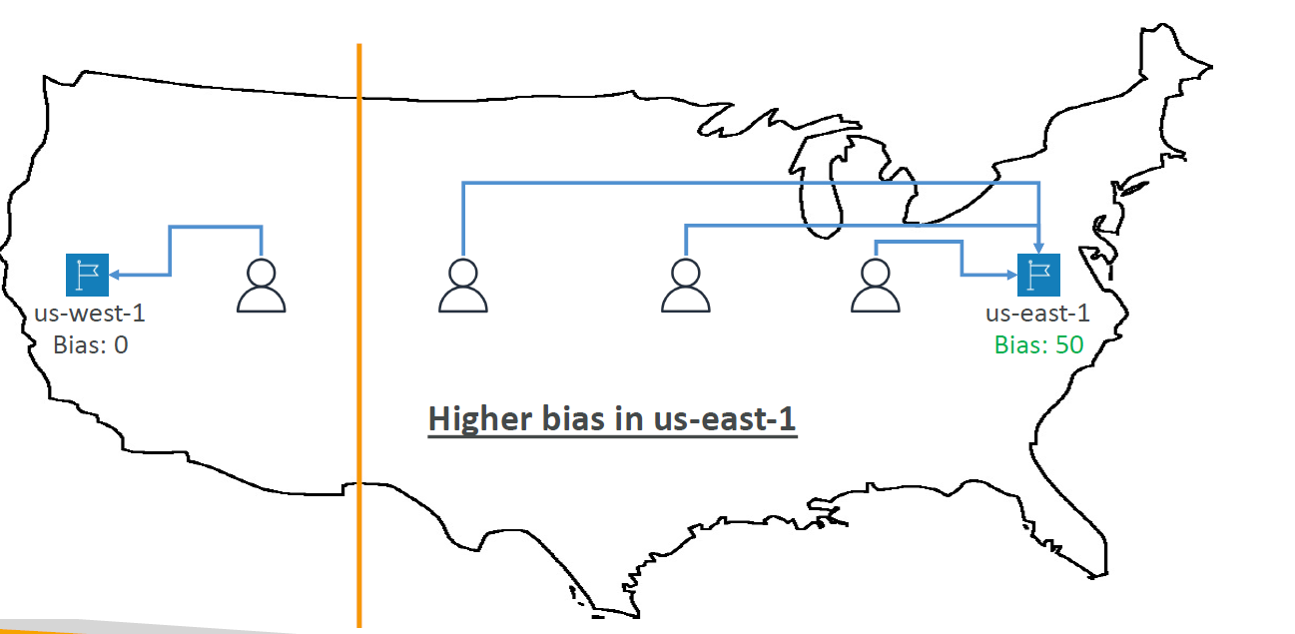
Routing Policies - Geoproximity

Slide 34
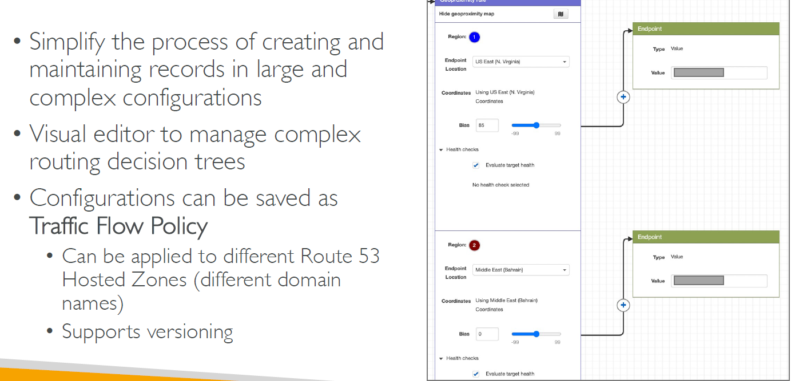
Route53 – Traffic Flow

Slide 35
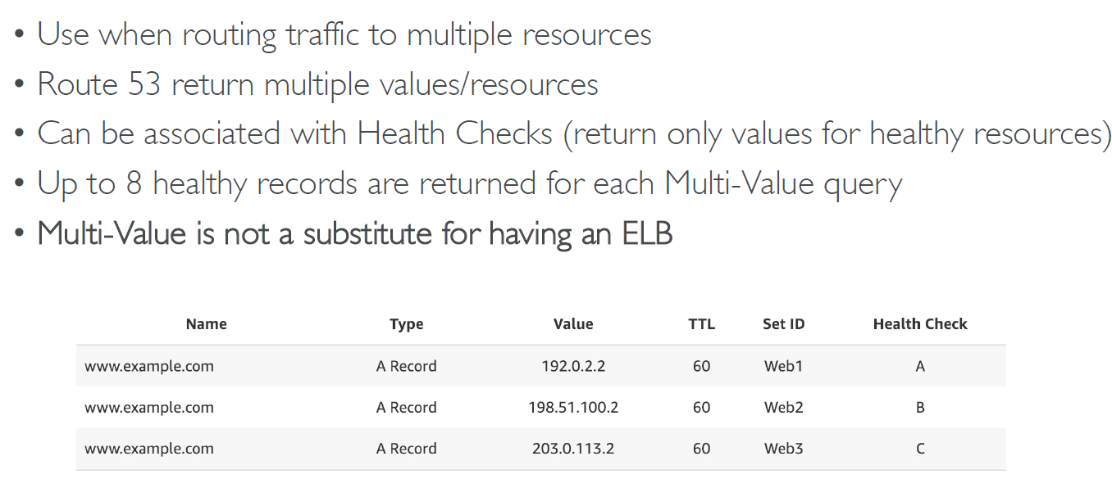
Routing Policies – Multi Value

Slide 36
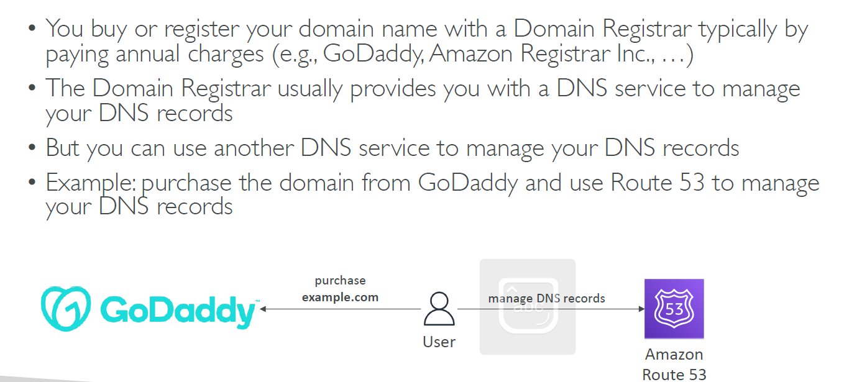
Domain Registrar vs DNS Service

Slide 37
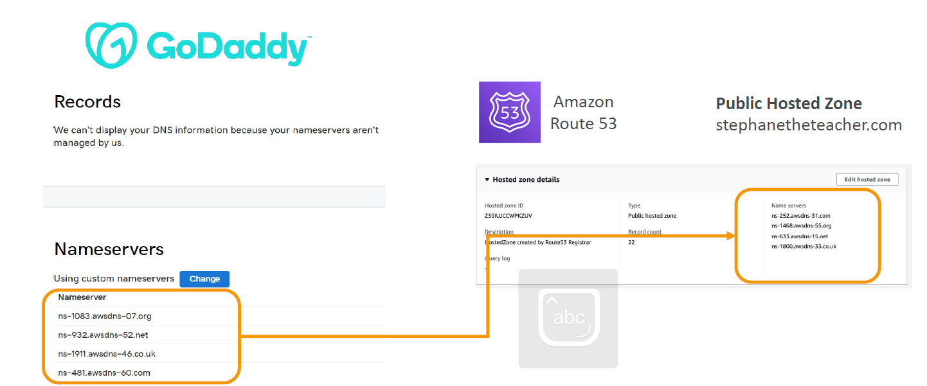
GoDaddy as Registrar & Route 53 as DNS Service

Slide 38
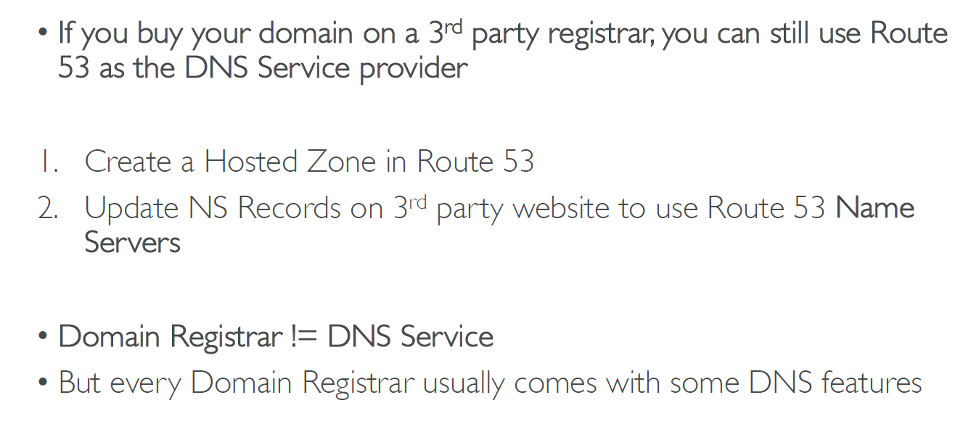
3rd party registrar with amazon route 53

